Slide 1


AKASH S DASS
13-07-2023

Slide 2

Outline
Executive Summary
Introduction
Methodology
Results
Conclusion
Appendix

Slide 3
Executive Summary
Data Collected
Normalized and Analyzed
EDA and Visualized
Launch site Payload and many combinations of relations Analyzed
Launch Sites Analyzed to find relationships between Success and Failure
Machine Learning Finding the Best Hyperparameter for SVM ,Classification , Trees and Logistic Regression .

Slide 4
Introduction
The Project is collecting and analyzing data and Predicting , finding the best hyperparameter of the model that is accurate
Is there a link between the Launch Location and the payload or rocket and payload that defone the success or failure of the launch

Slide 5

Section 1

Slide 6
Methodology
Executive Summary
Data collection methodology:
The data was collected by requesting SpaceX API using requests
Perform data wrangling
Data was checked for null values and Missing values
Perform exploratory data analysis (EDA) using visualization and SQL
Yes it was done
Perform interactive visual analytics using Folium and Plotly Dash
Yes it was done
Perform predictive analysis using classification models
Train test split was used and classification was done

Slide 7
Data Collection
Describe how data sets were collected.
Libraries were installed then defined the functions that extracts the launch data and columns rocket , launch pad , payload , cores .
Then Requested the Rocket launch data from SpaceX using Requests
Then converted the data to a Pandas Data Frame
Filtered the dataframe to include Falcon 9 Launches
Checked for null values and missind values
Replaced missing values with mean value of payloadmass column

Slide 8
Data Collection – SpaceX API
Link to Git Hub
IBM-DATA-SCIENCE-CAPSTONE-SPACEX-PROJECT-/IBM DATA SCIENCE CAPSTONE PROJECT SPACEX FILE/1 spacex-data-collection-api.ipynb at main · gitAkashDass/IBM-DATA-SCIENCE-CAPSTONE-SPACEX-PROJECT- · GitHub
Libraries were installed then defined the functions that extracts the launch data and columns rocket , launch pad , payload , cores .
Then Requested the Rocket launch data from SpaceX using Requests
Then converted the data to a Pandas Data Frame
Filtered the dataframe to include Falcon 9 Launches
Checked for null values and missind values
Replaced missing values with mean value of payloadmass column

Slide 9
Data Collection - Scraping
Link to github
IBM-DATA-SCIENCE-CAPSTONE-SPACEX-PROJECT-/IBM DATA SCIENCE CAPSTONE PROJECT SPACEX FILE/2 webscraping.ipynb at main · gitAkashDass/IBM-DATA-SCIENCE-CAPSTONE-SPACEX-PROJECT- · GitHub
Imported Beautifulsoup , requests and all the necessary liabraryes
Created a Beautifulsoup object from html response
Extracted all the data and then extracted all the columns and headsrs
Created a Data Frame by parsing the launch html tables

Slide 10
Data Wrangling
Imported all the libraries and defined the functions
Read the data in the data frame and looked at the head using df.head(10)
Checked for shape and null values checked data types
Calculated the number id launch sites CCAFS SLC 40 (55) , KSC LC 39A (22) , VAFB SLC 4E (13)
Calculated the number and occurrences of each orbit
Calculated the number and occurrence of mission outcome per orbit type
Created a landing outcome label from outcome column
Link : IBM-DATA-SCIENCE-CAPSTONE-SPACEX-PROJECT-/IBM DATA SCIENCE CAPSTONE PROJECT SPACEX FILE/3 spacex-data_wrangling.ipynb at main · gitAkashDass/IBM-DATA-SCIENCE-CAPSTONE-SPACEX-PROJECT- · GitHub

Slide 11
EDA with Data Visualization
sns.catplot was used to measure the flight number and payload variables to check its effect on launch outcome.
plt.scatter was used to find relationship between flight number and launch site
Sns.scatter plot was used for payload vs launch site
sns.catplot was used to flight number vs launch site
Sns.boxplot , many more were used refer to the link
IBM-DATA-SCIENCE-CAPSTONE-SPACEX-PROJECT-/IBM DATA SCIENCE CAPSTONE PROJECT SPACEX FILE/5 eda-dataviz.ipynb.ipynb at main · gitAkashDass/IBM-DATA-SCIENCE-CAPSTONE-SPACEX-PROJECT- · GitHub

Slide 12
EDA with SQL
Task 1 was to Display names of unique launch site in space mission solution was %sql SELECT DISTINCT launch_site FROM SPACEXBL
Task 2 was display 5 records where launch sites begain with “CCA” solution was %sql SELECT * FROM SPACEXBL WHERE launch_site LIKE ‘CCA%’ LIMIT(5)
Task 3 was display the total payload mass carried by boosters launched by NASA (CRS) solution %sql SELECT SUM(PAYLOAD_MASS_KG_) AS total_payload_mass FROM SPACEXBL WHERE customer = ‘NASA (CSS)’
Task 4 display average payload mass carried by booster version F9 v1.1 solution %sql SELECT AVG(PAYLOAD_MASS_KG_) AS average_payload_mass FROM SPACEXBL WHERE Booster_version = ‘F9 v1.1’ (CHECK THE LINK BELOW FOR MORE )
IBM-DATA-SCIENCE-CAPSTONE-SPACEX-PROJECT-/IBM DATA SCIENCE CAPSTONE PROJECT SPACEX FILE/4 EDA withsql-coursera_sqllite.ipynb at main · gitAkashDass/IBM-DATA-SCIENCE-CAPSTONE-SPACEX-PROJECT- · GitHub

Slide 13
Build an Interactive Map with Folium
I created a Map object, with an initial center location to be NASA Johnson Space Center at Houston. Then I used folium.Circle to add a highlighted circle area with a text label on a specific coordinate ie NASA Johnson Space Center.
Then I added folium.Circle and folium.Marker for each launch site on the site map
I created a launch result in spacex_df data frame, add a folium.Marker to marker_cluster
Then I created MousePosition on the map to get coordinate for a mouse over a point on the map
IBM-DATA-SCIENCE-CAPSTONE-SPACEX-PROJECT-/IBM DATA SCIENCE CAPSTONE PROJECT SPACEX FILE/6 _launch_site_location.jupyterlite.ipynb at main · gitAkashDass/IBM-DATA-SCIENCE-CAPSTONE-SPACEX-PROJECT- · GitHub

Slide 14
Build a Dashboard with Plotly Dash
Summarize what plots/graphs and interactions you have added to a dashboard
Explain why you added those plots and interactions
Add the GitHub URL of your completed Plotly Dash lab, as an external reference and peer-review purpose

Slide 15
Predictive Analysis (Classification)
All the details are mentioned in the link below
IBM-DATA-SCIENCE-CAPSTONE-SPACEX-PROJECT-/IBM DATA SCIENCE CAPSTONE PROJECT SPACEX FILE/7 Machine_Learning_Prediction.ipynb at main · gitAkashDass/IBM-DATA-SCIENCE-CAPSTONE-SPACEX-PROJECT- · GitHub

Slide 16
Results
Exploratory data analysis results
Interactive analytics demo in screenshots
Predictive analysis results

Slide 17

Section 2

Slide 18
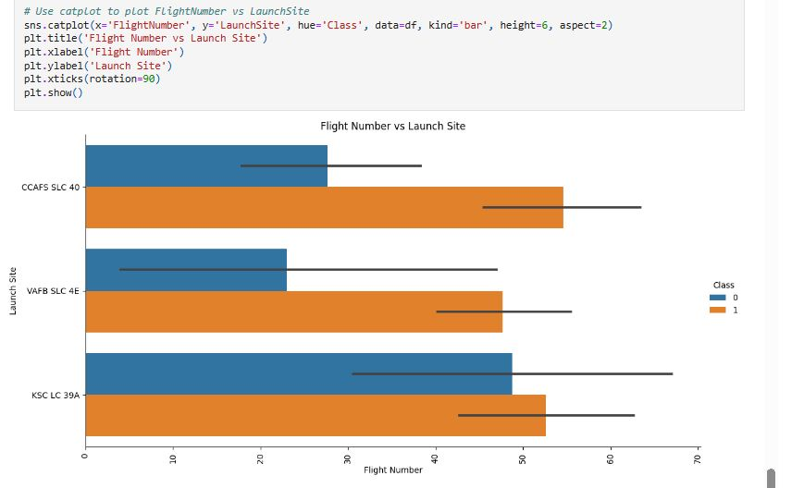
Flight Number vs. Launch Site
Catplot

Slide 19
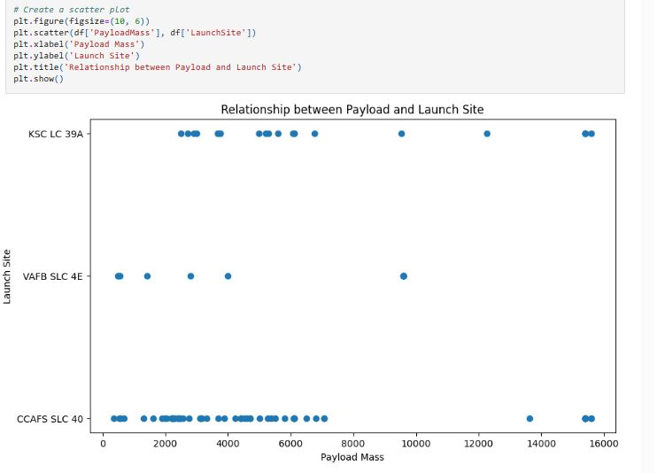
Payload vs. Launch Site

Slide 20
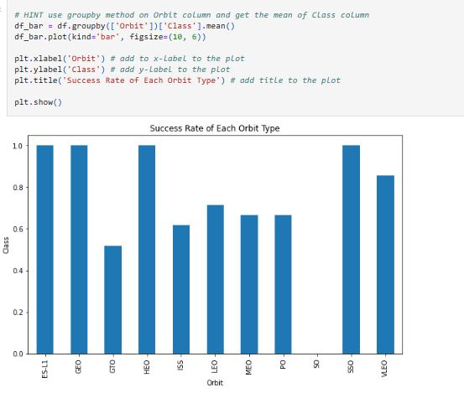
Success Rate vs. Orbit Type

Slide 21
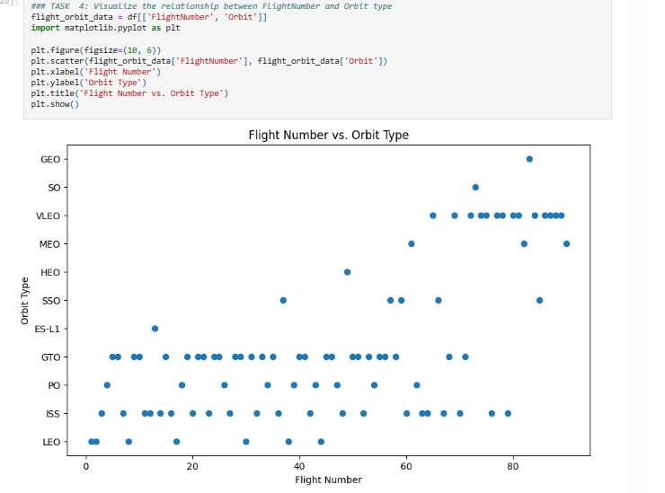
Flight Number vs. Orbit Type

Slide 22
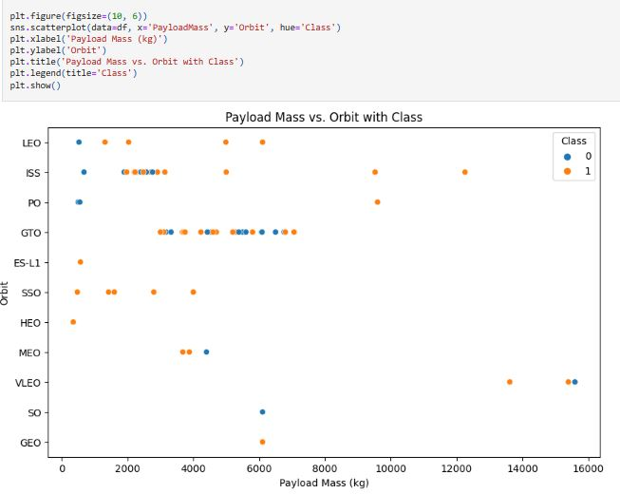
Payload vs. Orbit Type

Slide 23
Launch Success Yearly Trend
Show a line chart of yearly average success rate
Show the screenshot of the scatter plot with explanations

Slide 24
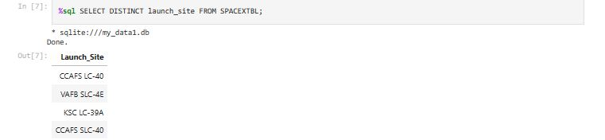
All Launch Site Names

Slide 25
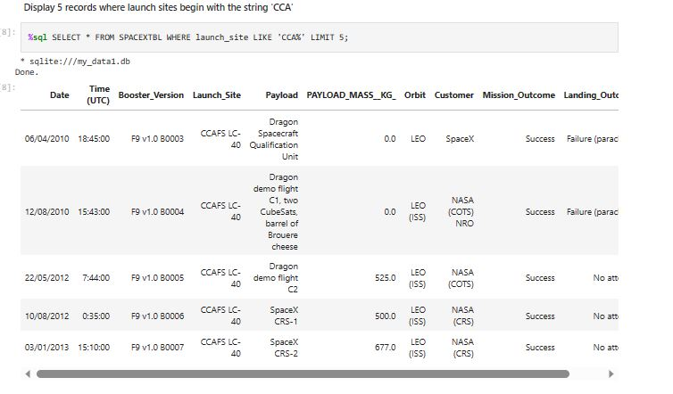
Launch Site Names Begin with 'CCA'

Slide 26
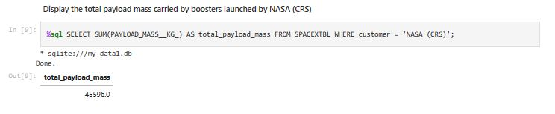
Total Payload Mass

Slide 27
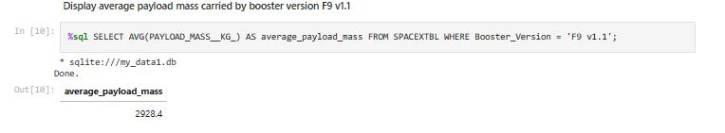
Average Payload Mass by F9 v1.1

Slide 28
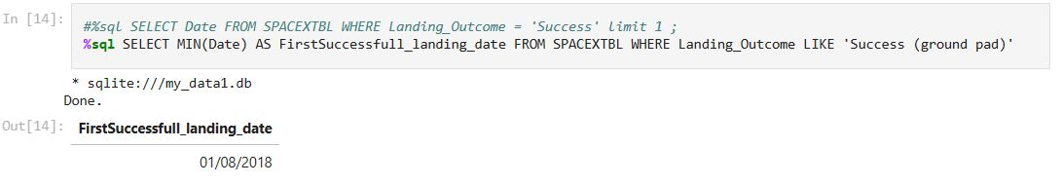
First Successful Ground Landing Date

Slide 29
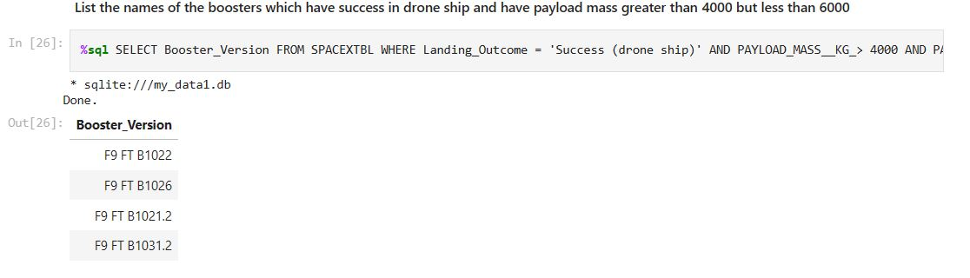
Successful Drone Ship Landing with Payload between 4000 and 6000

Slide 30
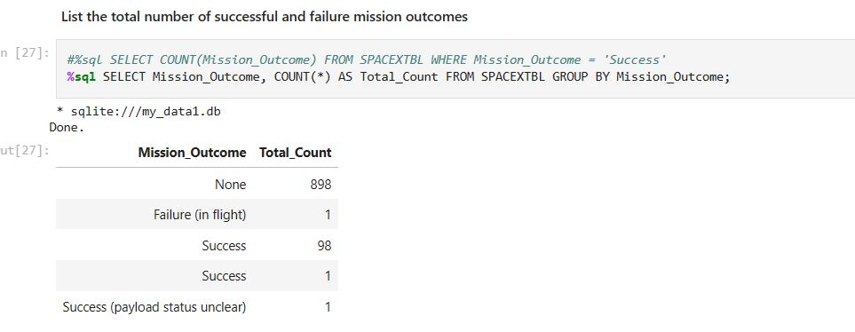
Total Number of Successful and Failure Mission Outcomes

Slide 31
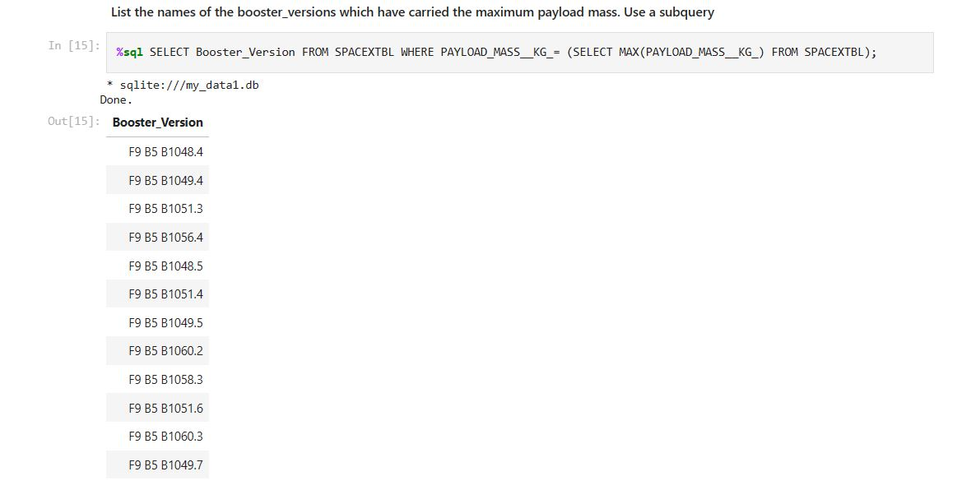
Boosters Carried Maximum Payload

Slide 32
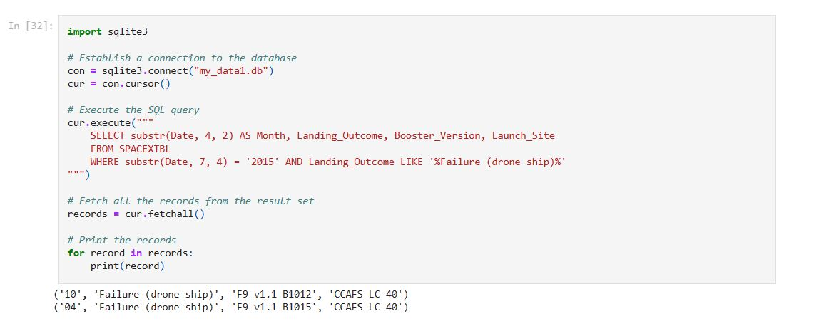
2015 Launch Records

Slide 33
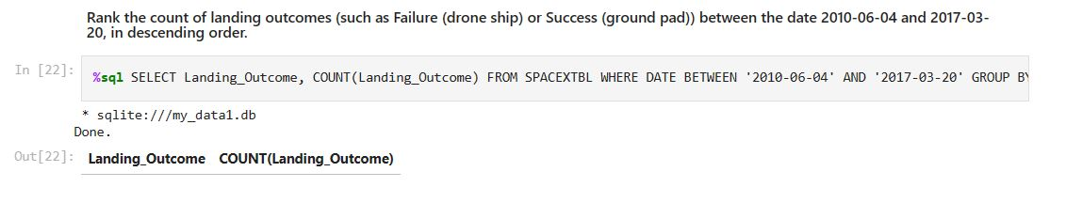
Rank Landing Outcomes Between 2010-06-04 and 2017-03-20

Slide 34

Section 3

Slide 35
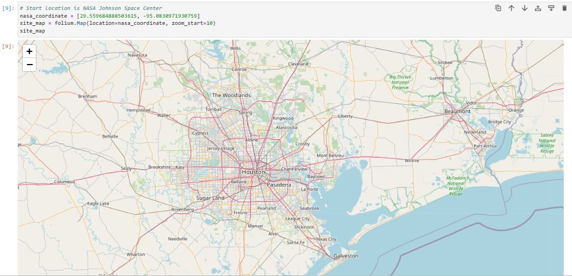
NASA Map Screenshot

Slide 36
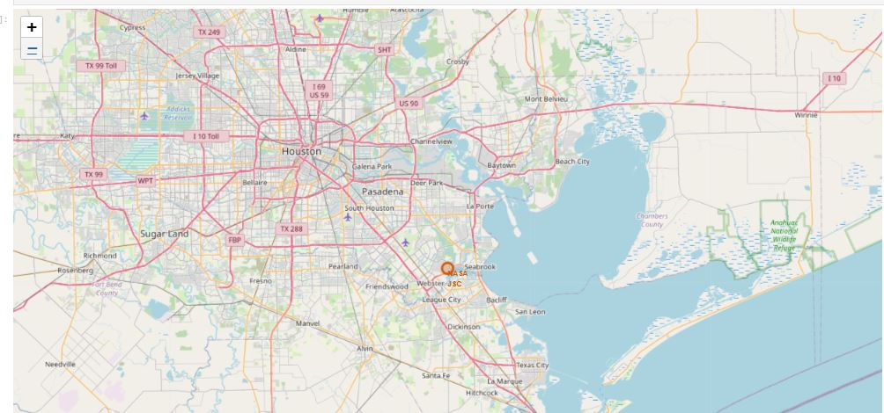
Task 2 Map Screenshot

Slide 37
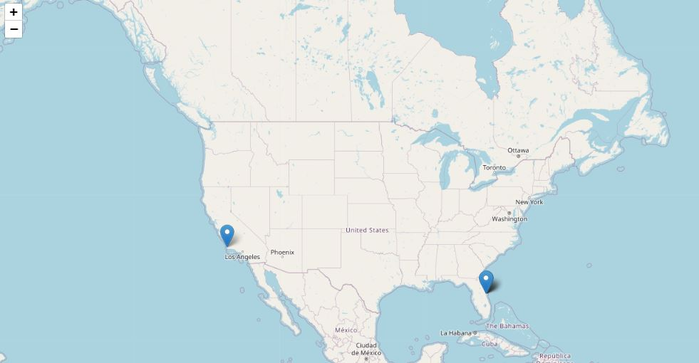
Map Screenshot

Slide 38

Section 4

Slide 39
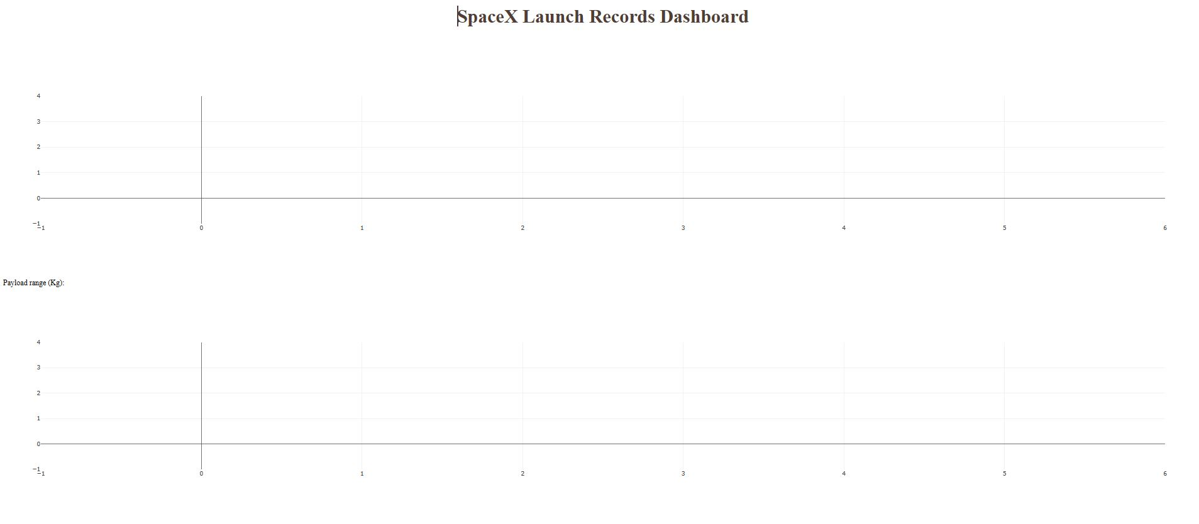
Dashboard using Plotly Screenshot

Slide 40
<Dashboard Screenshot 2>
Replace <Dashboard screenshot 2> title with an appropriate title
Show the screenshot of the piechart for the launch site with highest launch success ratio
Explain the important elements and findings on the screenshot

Slide 41
<Dashboard Screenshot 3>
Replace <Dashboard screenshot 3> title with an appropriate title
Show screenshots of Payload vs. Launch Outcome scatter plot for all sites, with different payload selected in the range slider
Explain the important elements and findings on the screenshot, such as which payload range or booster version have the largest success rate, etc.

Slide 42

Section 5

Slide 43
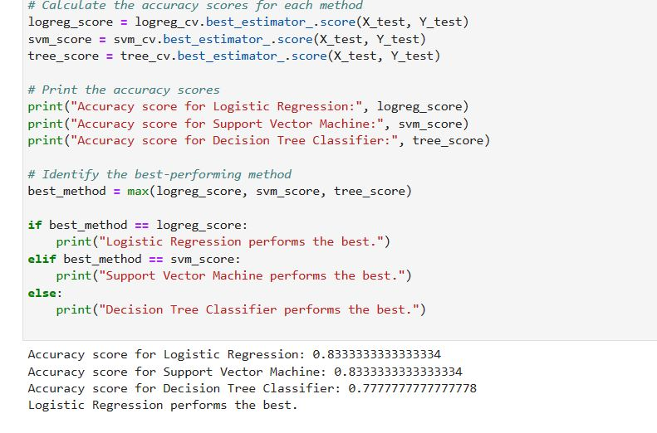
Classification Accuracy = Logistic regression performs best

Slide 44
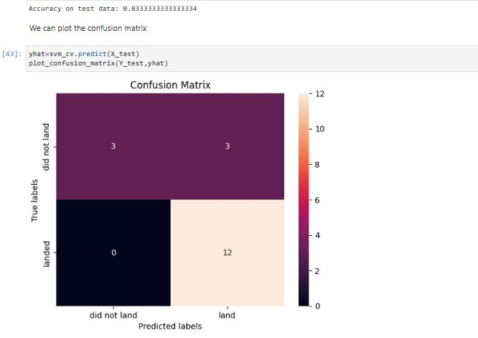
Confusion Matrix of Logistic Regression

Slide 45
Conclusions
Accuracy score for logistic regression : 0.8333333333333334
Accuracy score for Support Vector Machine: 0.83333333333333
Accuracy score for Decision Tree Classifier : 0.77777777777778
Logistic Regression Performs the Best.

Slide 46
Appendix
From Web Scraping to ML Models the entire files are uploaded to the github .
Thank You Coursera
Thank You IBM Data Science course Instructors

Slide 47


